Slide 1
FAKE NEWS DETECTION
Sanjay Kumar
May 2020-Cohort

Slide 2
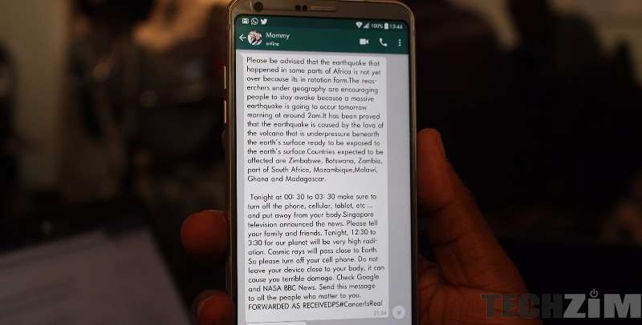
How many of you receive forwarded news on Whatsapp?

Slide 3
How many of you verify each and every piece of news you read before believing it?

Slide 4
Research shows that 1 in 2 Indians receives fake news via Whatsapp and Facebook
As per a survey by Social Media Matters and Institute for Governance, Policies and Politics
SO WHY IS IDENTIFYING FAKE NEWS IMPORTANT?
Because when we don’t, we can be fooled or manipulated- into worsening existing stereotypes,
getting worried about fake disease epidemics, or even influencing whom we vote for.

Slide 5
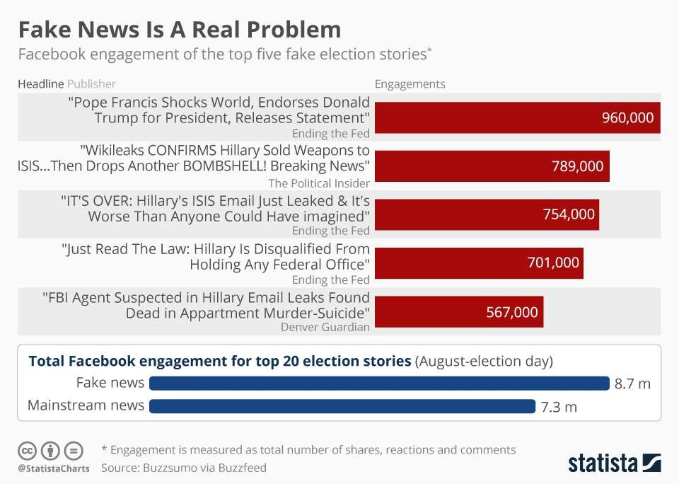

Slide 6
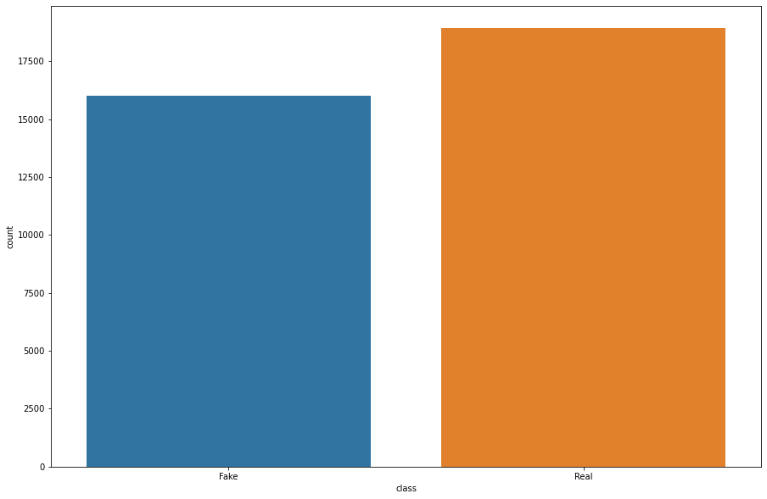
How we set up our problem and data
Since the csv files has two sets of news : Fake.csv and True .csv.
Process involved data wrangling,Exapolaratory Data analysis,Preprocessing & Training data development,Modeling and prediction
List of fake vs Real news

Slide 7
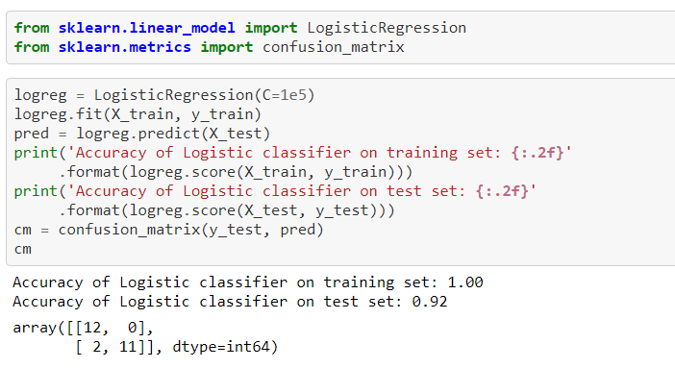





modelling
A combination of bag-of-words, tfidf-vector, and the feature
description model was found to be the
one which showed us maximum accuracy and then apply logistic regression and MultiNB regression for modeling and last prediction on Test data csv files to predict the fake or real news.
For eg: logistic regression as mentioned on the image.

Slide 8
92.00%
Test accuracy

Slide 9
To improve:
Instead of using only 16 features, we changed to using 616 features in our word-2-vec model, which was one of the key factors for improving our accuracy
Using controversial words which were seen to appear more in fake news than in real. Eg. bombing, terrorist, Trump

Slide 10
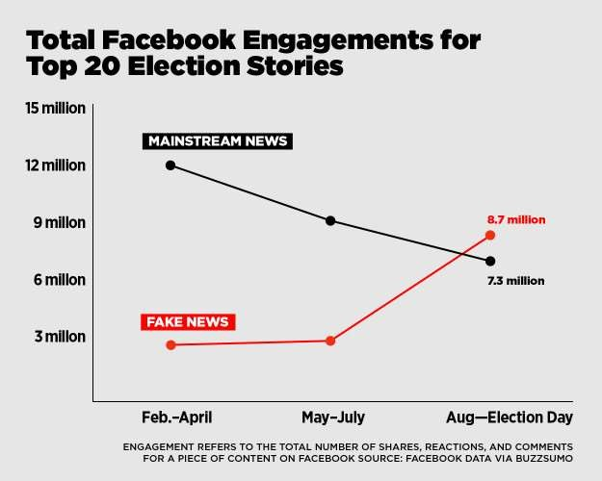

Real-World Applications
Elections
Fake job rackets
Checking the credibility of news links received on Whatsapp ,
Facebook , Twitter
Fake medical news messages

Slide 11
Case Study-Job rackets
Fishing at reputed job portals: Another way of conning job aspirants is through reputed job portals where racketeers fish for personal details of job seekers and exploit them later.
"They build a database of critical personal information of unsuspecting candidates which can be dangerously misused at a later point,” says Chakraborty. In June, police arrested three men from Kavi Nagar in Ghaziabad for allegedly cheating several job seekers of around Rs 3.5 crore in the last two years.
The mastermind of the racket posed on Naukri.com as representative of fictitious companies such as Idea International and Entomace Technology India Pvt Ltd and posted jobs. He would collect personal data of candidates who applied to those jobs. Later, he would send them fake interview letters from big, well-known companies. He wanted the candidates to pay through Paytm for fixing the interviews so they would get those jobs.

Slide 12
Real-World Implementation
To implement this in real life, we can make a mobile app or a Whatsapp-integrated feature.
Users would simply enter the link of a news website and be able to verify whether a news website is true or fake.
In the future, our improved model could also consider individual news stories and not just the news website as a whole.

Slide 13
Thank you!

